Slide 1
CHAPTER-6
APPLICATIONS OF DERIVATIVES
CONTENT
INTRODUCTION
EXAMPLES
INCREASING /DECREASING FUNCTIONS
FIRST DERIVATIVE TEST
SECOND DERIVATIVE TEST
APPROXIMATTION
TANGENTS AND NORMALS
MAXIMA AND MINIMA

Slide 2
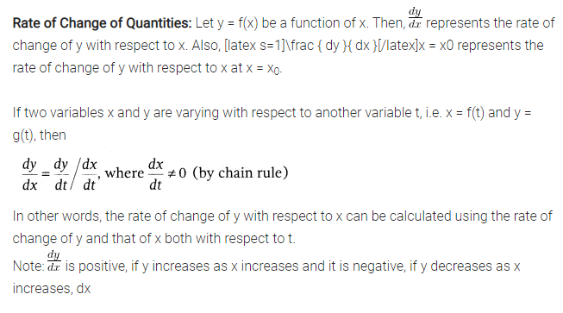
APPLICATIONS OF DERIVATIVES

Slide 3
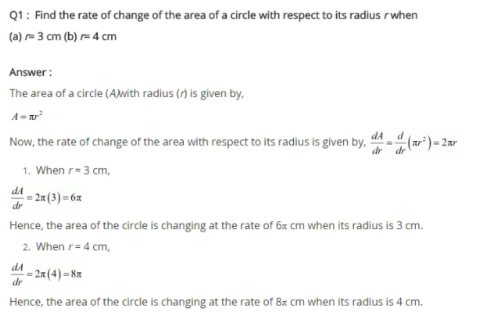

Slide 4
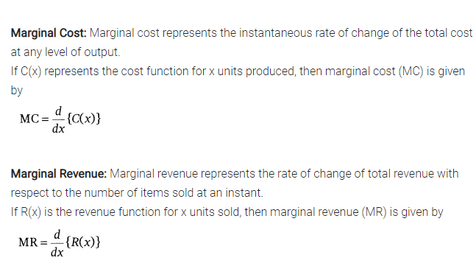
EXAMPLES

Slide 5
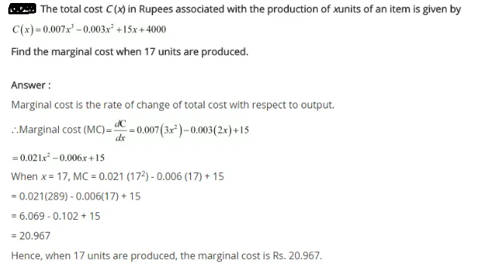

Slide 6
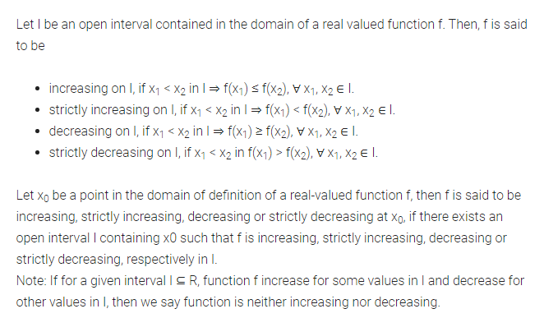
INCREASING /DECREASING FUNCTIONS

Slide 7
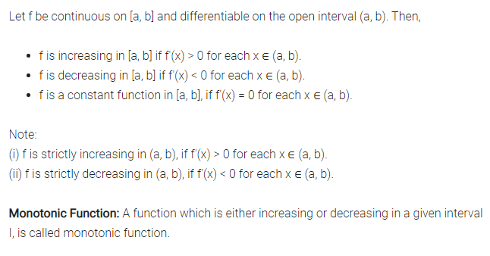
INCREASING /DECREASING FUNCTIONS

Slide 8
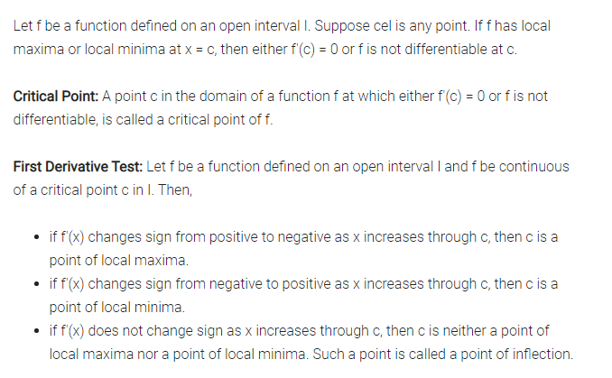
FIRST DERIVATIVE TEST

Slide 9
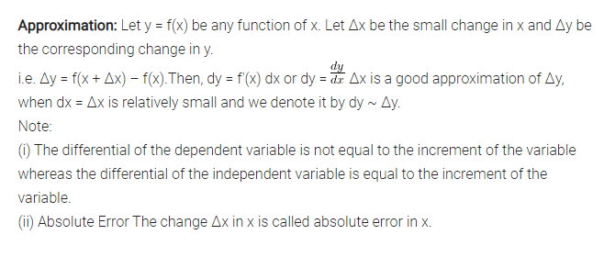
APPROXIMATTION

Slide 10
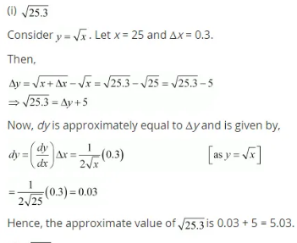
Finding the approximate value

Slide 11
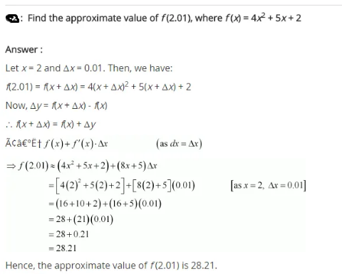

Slide 12
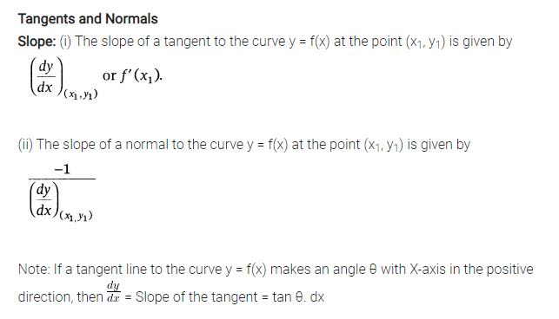
TANGENTS AND NORMALS

Slide 13
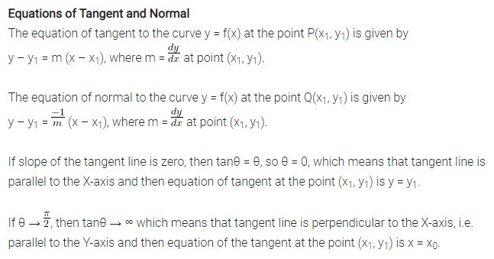
TANGENTS AND NORMALS

Slide 14
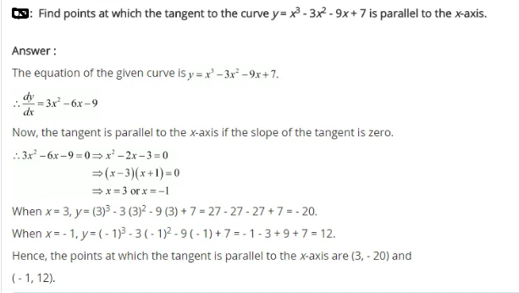

Slide 15
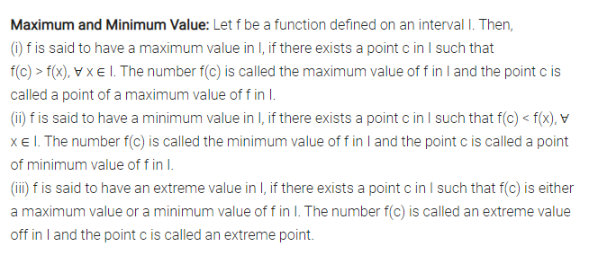
MAXIMA AND MINIMA

Slide 16
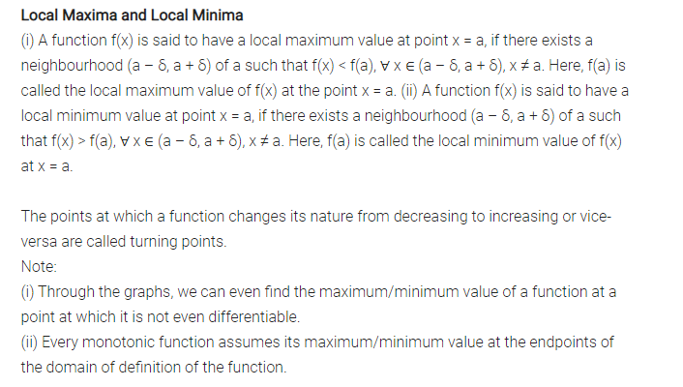
MAXIMA AND MINIMA

Slide 17
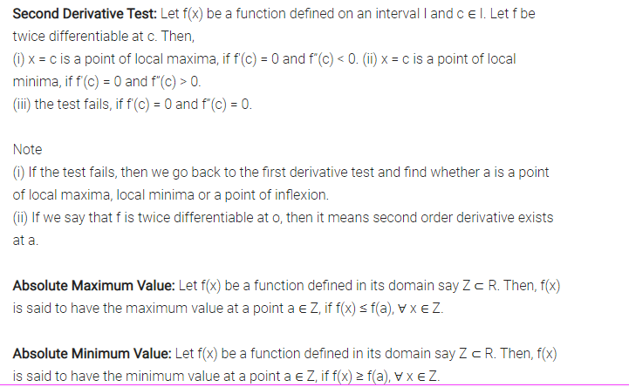
SECOND DERIVATIVE TEST

Slide 18
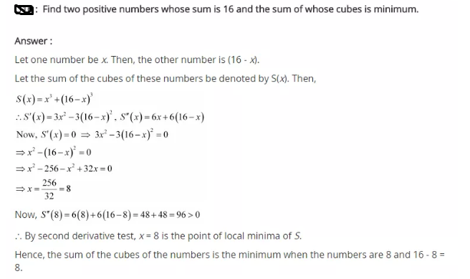

Slide 19
IMPORTANT FACTS
Absolute Minimum Value: Let f(x) be a function defined in its domain say Z ⊂ R. Then, f(x) is said to have the minimum value at a point a ∈ Z, if f(x) ≥ f(a), ∀ x ∈ Z.
Absolute Maximum Value: Let f(x) be a function defined in its domain say Z ⊂ R. Then, f(x) is said to have the maximum value at a point a ∈ Z, if f(x) ≤ f(a), ∀ x ∈ Z.
Every continuous function on a closed interval has a maximum and a minimum value.
Every continuous function defined in a closed interval has a maximum or a minimum value which lies either at the end points or at the solution of f'(x) = 0 or at the point, where the function is not differentiable.
Let f be a continuous function on an interval I = [a, b]. Then, f has the absolute maximum value and/attains it at least once in I. Also, f has the absolute minimum value and attains it at least once in I.

